Slide 1
Visualization of Encryption
By Vibha Pandurangi

Slide 2
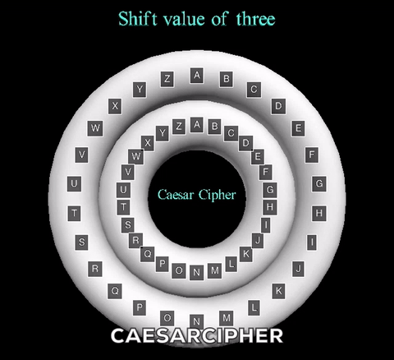
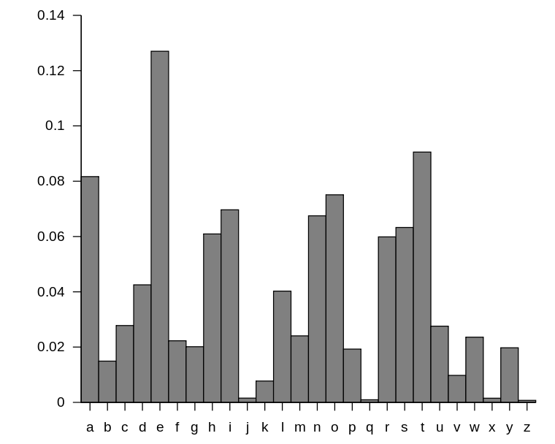
Part I: Caesar Cipher
Mono-alphabetic shift
A shift known in advance
Works with modulo 26 (shift of 33: 33%26 = 7)
Broken through frequency analysis

Slide 3
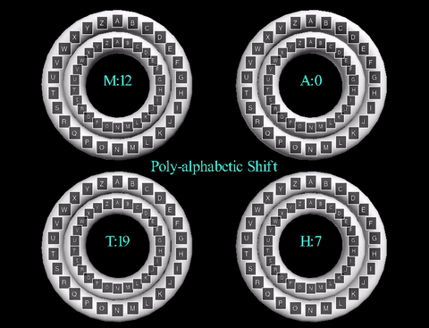
Part II: Polyalphabetic Cipher
Uses a secret shift word rather than a singular shift key
Multiple shift instead of single shift
Main concept: multiple Caesar Ciphers
Decrypted through:
Determine length of key word (n)
Frequency analysis/cracking n Caesar Ciphers
Longer shift word = more time consuming to break

Slide 4
Breaking Poly-alphabetic
1. Check all
TEKLUSTSUSMVRRTUPOFPLEWDA RWZSRTZEHHWBEKJMRMLXCTKMV XYOOFIGSMPNLXIQSMPMLTJMDX TUCUVMRWLDOYMUCXYOOKYASBC QBEHOKALMRMIUBELARUWUNVON AZIQAKKBOPLDBXHZAZLMNMPHI KHXGEPFTXYTOPJAOEPETAHFIY ATILTQSLHSEPHELHUSEKATILD AUEKIOKR
2. TEKLUSTSUSMVRRTUPOFPLEWDA RWZSRTZEHHWBEKJMRMLXCTKMV XYOOFIGSMPNLXIQSMPMLTJMDX TUCUVMRWLDOYMUCXYOOKYASBC QBEHOKALMRMIUBELARUWUNVON AZIQAKKBOPLDBXHZAZLMNMPHI KHXGEPFTXYTOPJAOEPETAHFIY ATILTQSLHSEPHELHUSEKATILD AUEKIOKR
3. TEKLUSTSUSMVRRTUPOFPLEWDA RWZSRTZEHHWBEKJMRMLXCTKMV XYOOFIGSMPNLXIQSMPMLTJMDX TUCUVMRWLDOYMUCXYOOKYASBC QBEHOKALMRMIUBELARUWUNVON AZIQAKKBOPLDBXHZAZLMNMPHI KHXGEPFTXYTOPJAOEPETAHFIY ATILTQSLHSEPHELHUSEKATILD AUEKIOKR
etc. until the frequency distribution matches the standard one for the English language

Slide 5
Enigma Encryption Machine
Rotor encryption machine
Goal of encryption technology during WWII for Germany was to automate the one-time pad using an encryption machine in order to be able to plan and execute surprise attacks
Ideally: machine will accept an input letter, apply a random shift, and output the encrypted letter
Failed because of human error in randomizing the initial position of the rotors and design error that caused uneven frequency distribution

Slide 7
Perfect Secrecy
Result of randomness
Problem: Long keys have to be shared in advance
Development of pseudo-randomness
Algorithm for middle squares method:
Select random number called “seed”, which is provided as input to the calculation
Seed*Seed
Output = middle of this result
Difference between true randomness and pseudo-randomness:
Pseudo-randomness must eventually repeat (called the “period’)
Limited by length of initial seed
With pseudo-randomness, there are many sequences that cannot occur
Next result based on the previous one
Shrink the key space into much smaller seed space
Must be impractical for a computer to search through all seeds

Slide 8
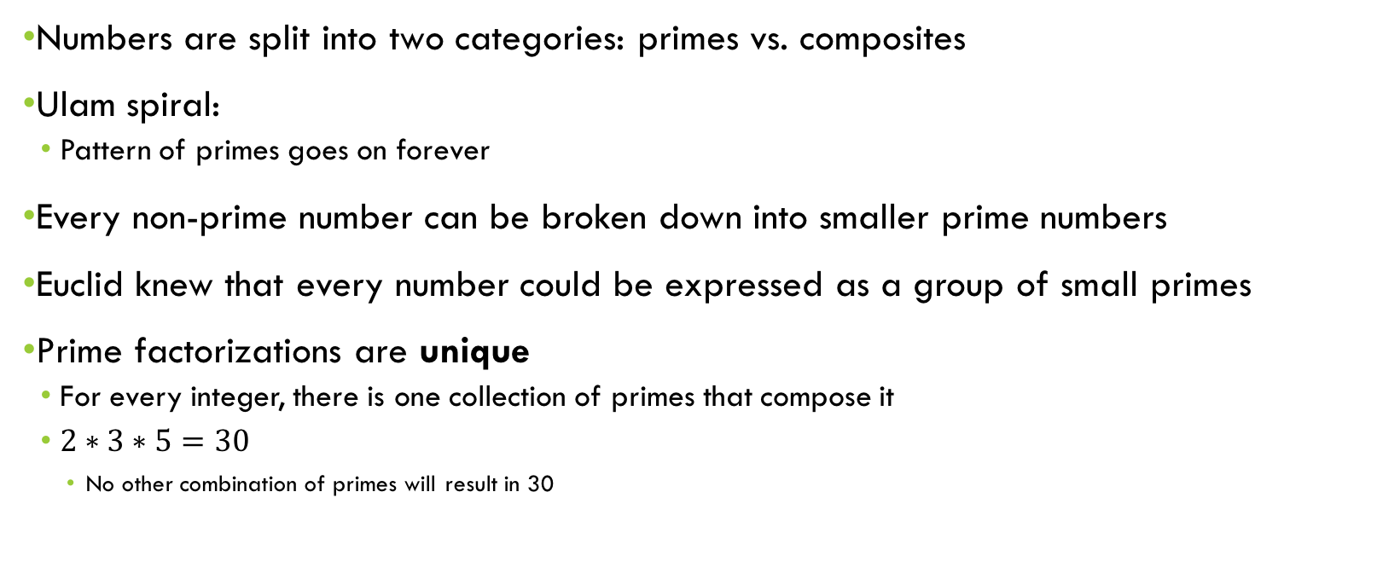
Fundamental Theorem of Arithmetic
Numbers are split into two categories: primes vs. composites
Ulam spiral:
Pattern of primes goes on forever
Every non-prime number can be broken down into smaller prime numbers
Euclid knew that every number could be expressed as a group of small primes
Prime factorizations are unique
For every integer, there is one collection of primes that compose it
$2∗3∗5=30$
No other combination of primes will result in 30

Slide 10
Public key Encryption (simplified)
Based on one-way functions
Easy one way, hard to reverse
Modular arithmetic
Allows for encryption without sharing key beforehand
Asymmetric cryptography: uses public and private keys to share information (key-pair)
One to encrypt, other to decrypt
Lock box example
Goal: Party A and Party B have a secure private key, with which they could exchange information, without having shared the key beforehand
Public key known to everyone
Extremely difficult or impossible to derive private key from public

Slide 11
Visualization of the concept
Model of one-way function through colors:
Easy to mix two colors together to get a new color (blue + yellow = green)
Hard to reverse to find exact original colors
Initial state: Two parties have their own secret private colors (private keys)
Secret even to each other
End goal: Secretly create a private color both parties have access to (the key to the encryption)
Presents the concept of creating the secret private key

Slide 12
Future Developments and Improvements
Increased user-interaction
Current: Only displays shift of 3 (and multiples of 3)
Allow user to input their shift and then reset, or choose their own key word
Translation to JavaScript
Facilitate the user interaction
More visible spin
Subtle right now (VPython labels)
Expanding the Public-Key Encryption visualization
Develop the current idea/RTICA
Cover the rest of PKE

