Slide 1
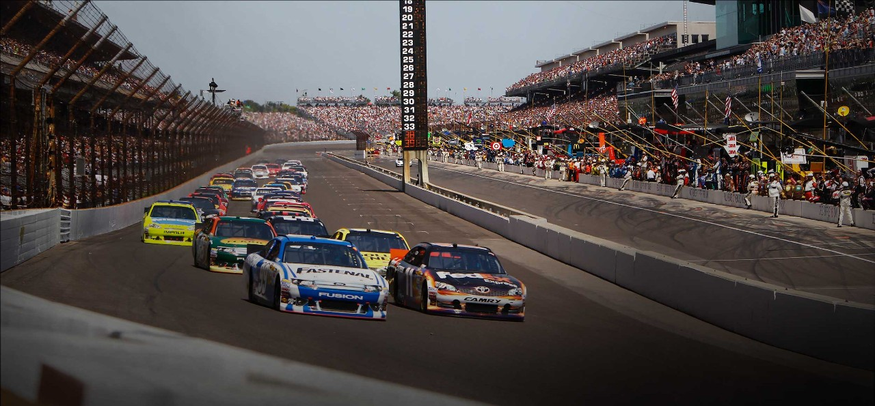
A Visualization of Automobile Racing
Nick Kasner

Slide 2

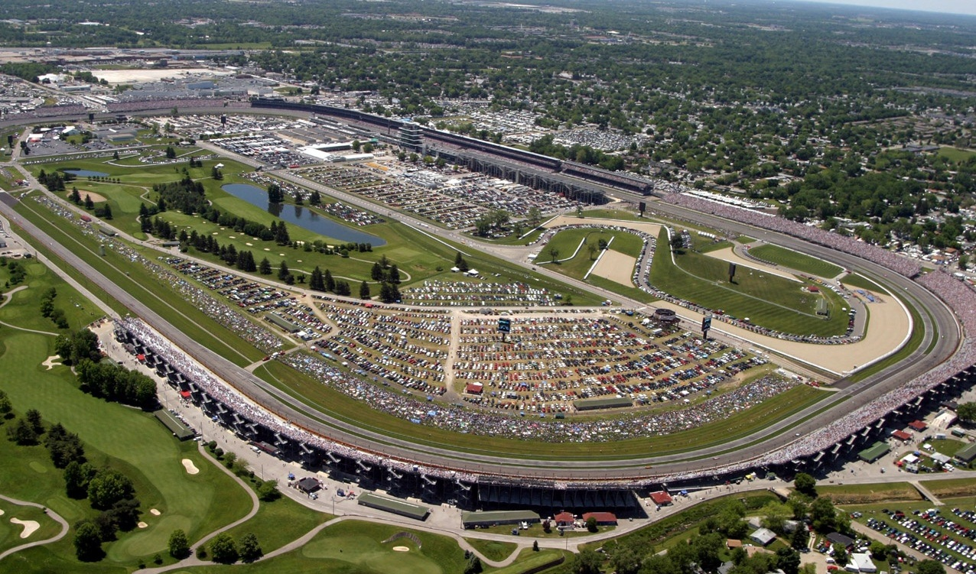
Background
Racing first used to test reliability of vehicles, later for competition
Oval track racing, counterclockwise around banked turns
NASCAR founded in 1948, Indianapolis Motor Speedway (1909)

Slide 3
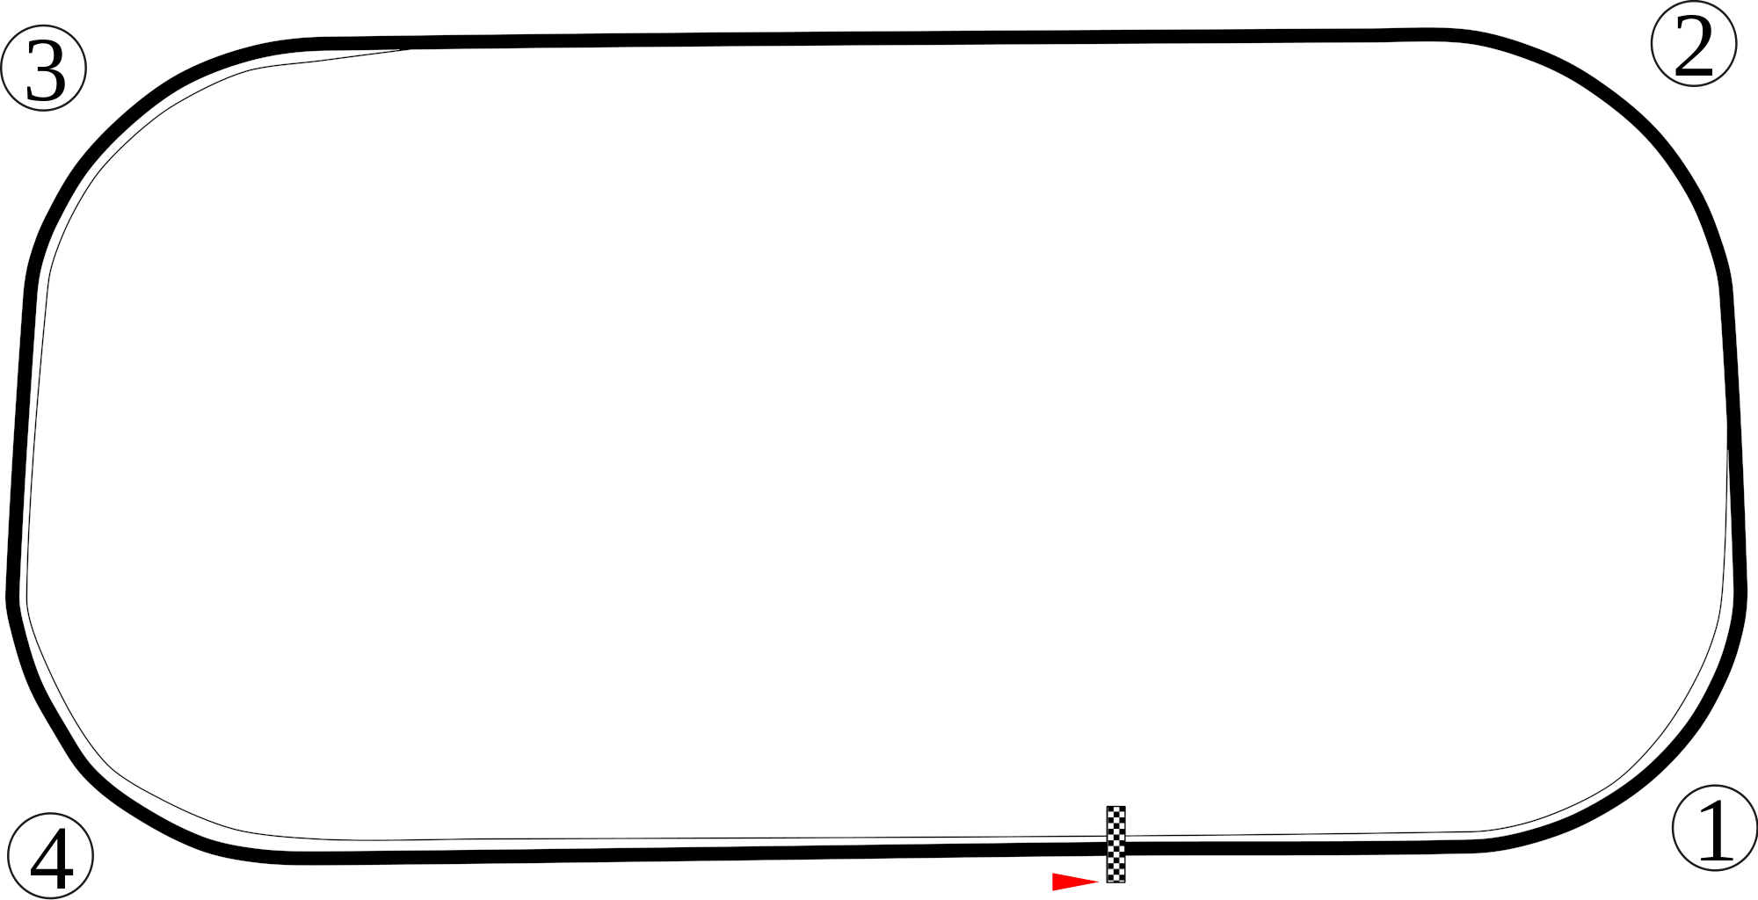
Oval Track Layout

Slide 4
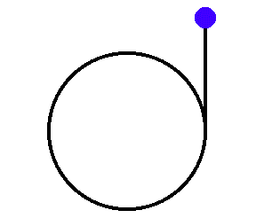
Kinetic Energy and Inertia
KE = ½ * mass * velocity²
Inertia: tendency of an object to resist change in motion
Newton’s First Law of Motion
Force needed to keep car moving around the turn
In a circle, Force_{toward center} = mass * velocity² / radius
Notes:
An object at rest stays at rest and an object in motion stays in motion with the same speed and in the same direction unless acted upon by an unbalanced force.

Slide 5
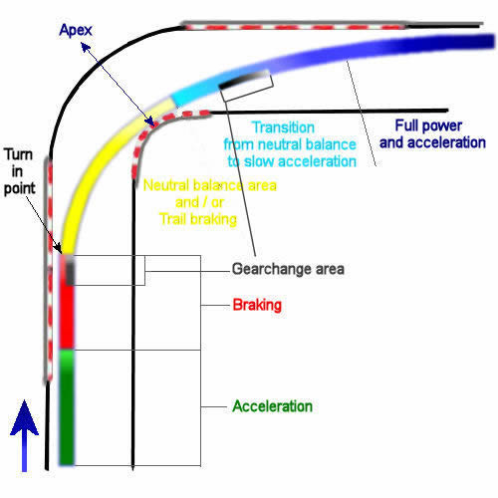
Cornering
Requires balance of braking / deceleration and finding the right line
Tires have a limited amount of grip
Car held in the turn by friction, banked curves
Friction can only do so much at high speeds

Slide 6
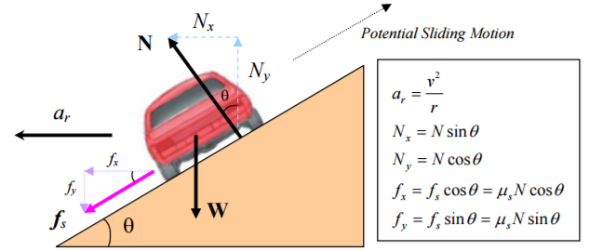
Banked Curves
Force needed to hold the car in the turn depends on its speed
Steep banking necessary for racecars to drive fast
Banking uses gravity to hold the car in the turn
Too much speed entering a turn would cause the car to slide up the track

Slide 7
Videos
https://www.youtube.com/watch?v=e4PwTYk2sEs
https://www.youtube.com/watch?v=3AjnR02O3mw

Slide 8
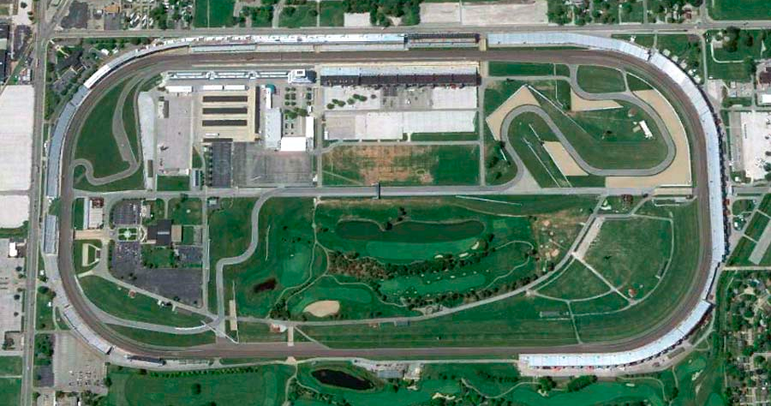
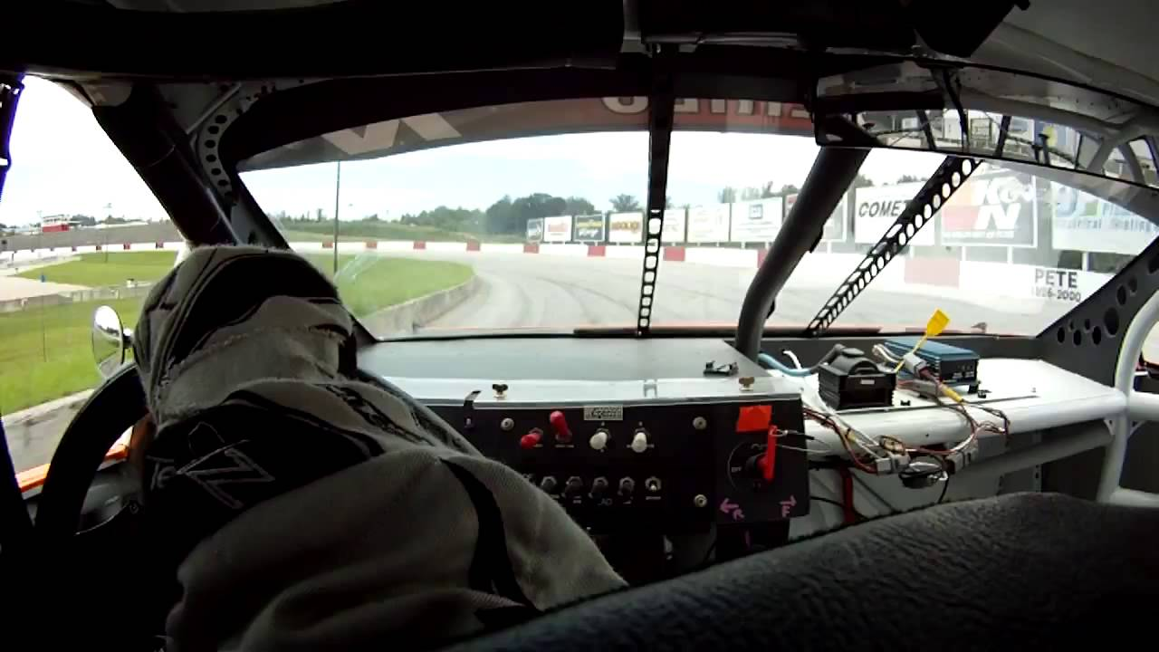
Project
Create an animation of a car driving around a racetrack with a separate view from inside the vehicle

Slide 9

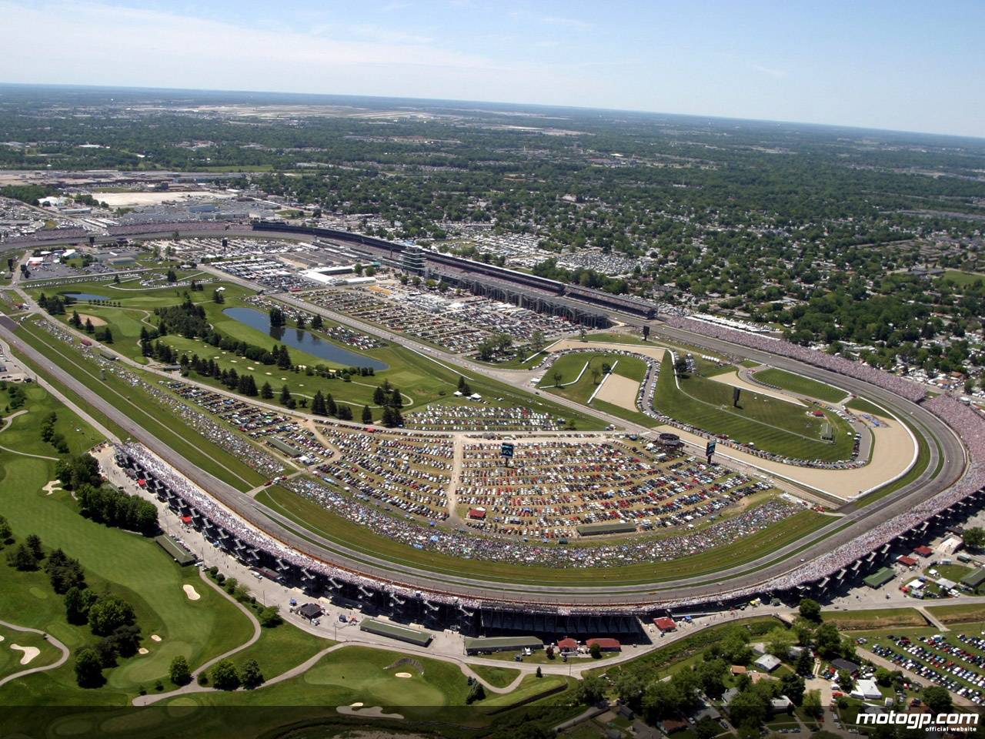
Perspectives

Slide 10
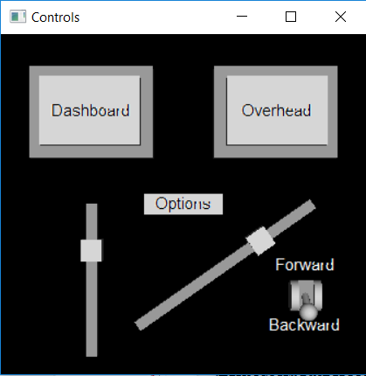
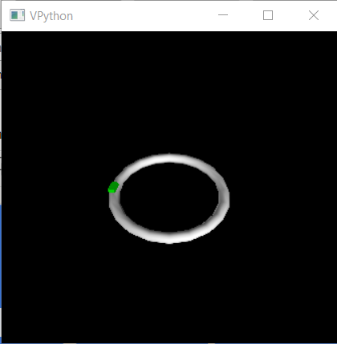
Program Layout
Speed
Direction
Camera

Slide 11
Sources
https://en.wikipedia.org/wiki/Auto_racing
http://www.formula1-dictionary.net/corners.html
http://www.formula1-dictionary.net/cornering_tech.html
http://www.batesville.k12.in.us/physics/phynet/mechanics/circular%20motion/banked_with_friction.htm

