Slide 1
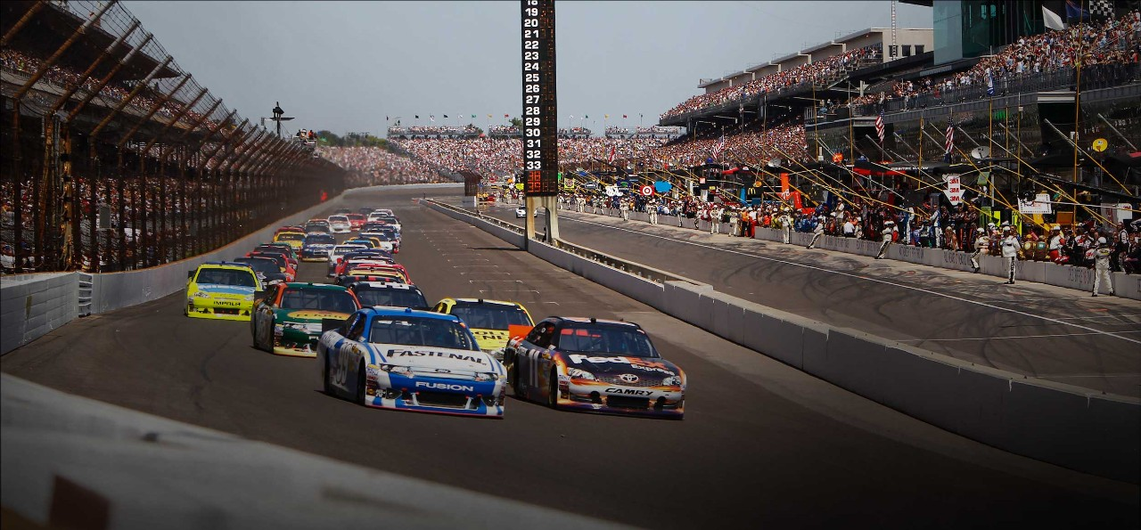
Indyracers: A VPython Program
Nick Kasner
MATH 198 / CS 199
December 14, 2016

Slide 2
Overview
Create a program that would simulate a car moving around a track from the perspective of the driver
Interest in racing from watching with my father
Ride along experience

Slide 3
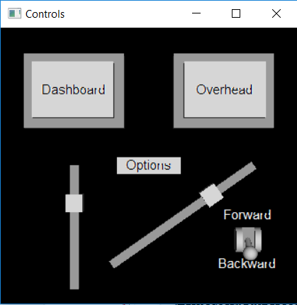
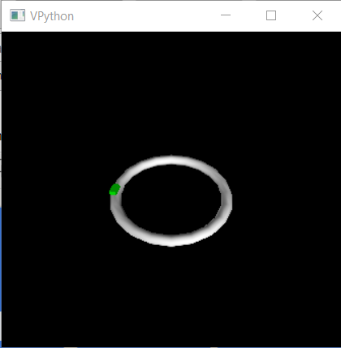
Proof of Concept
Side by side windows
No second camera
No scenery

Slide 4
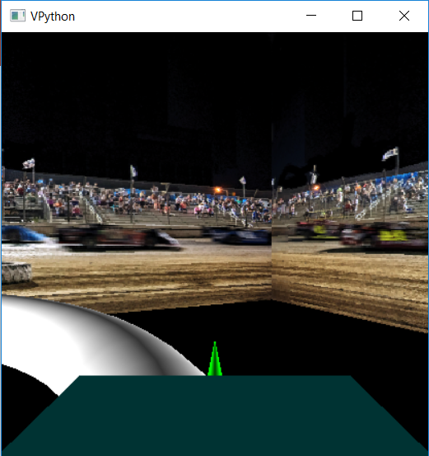
RTICA

Slide 5
Program Functionality
Two frames, ftrack and fcar
Various functions to organize code and effect desired features
Manipulations of “scene” commands to articulate the camera

Slide 6
VPython Camera
scene.center – origin of the “world”
scene.forward – vector pointing in direction of scene.center
scene.range – in essence, similar to “zoom”
Other functions I did not use (scene.fov, scene.range, scene.up)

Slide 7
Future Development
Similar to a work of literature, programs are constantly revised
Ran out of time to include all desired features
Camera was difficult to manipulate

Slide 8
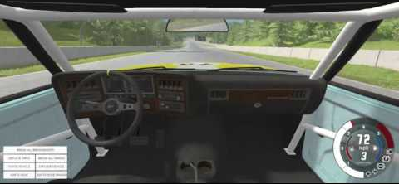
Control Panel / Dashboard
Existed in Proof of Concept, minimal functionality
Control speed, start and stop
Integrated with dashboard to simulate driving the car

Slide 9
Other Ideas
Multiple racecars
Wrap bleachers to cylinder instead of a cube

Slide 10
Conclusion
Course taught me a lot about debugging, keeping a repository, and working with VPython, HTML
Specifically, gained understanding of VPython scene
Organizational skills

