Slide 1
Kepler’s Laws: Universal or Not?
By Jake Ribich

Slide 2
Background and History

Slide 3
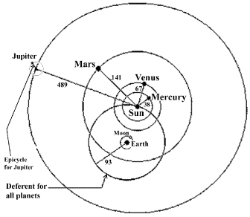
The Typical Human Ego
The earth is the center of the universe
Everything is rotating around us
The ground isn’t going anywhere

Slide 4
The Uphill Battle
Nicolaus Copernicus
Galileo Galilei
On the Revolutions of the Heavenly Spheres – 1543
Earth revolves around the sun
Couldn’t be justified better than Geocentrism
Went against scientific, religious, and philosophical beliefs
The moon has craters
Earth isn’t special
Venus goes through phases
More than one day orbits
Jupiter has moons
Moving celestial bodies can have orbiting bodies as well

Slide 5
The Uphill Battle
Johannes Kepler
Isaac Newton
The orbits are elliptical
Analyzed data
Came up with extremely accurate patterns
Kepler’s Laws of Planetary Motion - 1619
Still wasn’t quite enough
Universal Law of Gravitation - 1687
Mathematically derived Kepler’s laws
Much more believable when backed by math
Still wasn’t until 1838 until all of Copernicus’ assumptions were confirmed

Slide 6
The Project
2 + 1 Laws Illustrated

Slide 7
First Law
Goal with this program:
Illustrate the elliptical orbit that planets follow
Allow for some user interaction
Better understand how to make trails and curves

Slide 8
Second Law
Goal with this program:
Illustrate constant areal velocity
Provide a wide range of orbits for demonstration
Better use of trail and curve functions

Slide 9
Second Second Law
Hard to tell that the sections are equal in area
Had to hand calculate
np.random.choice() vs random()

Slide 10
In the Future
More values available for the second law
Figure out how to create a third law
Better calculation and display of numbers

