Slide 1
Manipulating the Rubik’s Cube

Slide 2
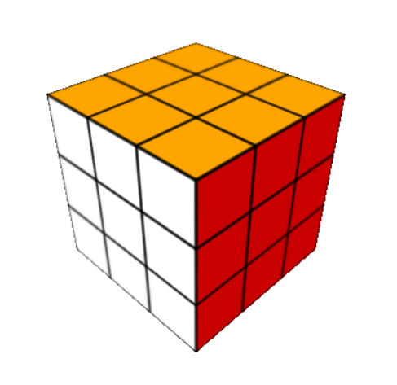
Background
Puzzle game
Invented by Erno Rubik in 1974
Goal: Solved Cube
Variations

Slide 3
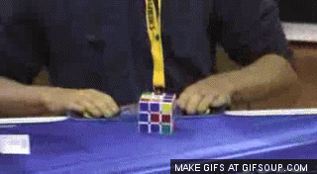
My Project Goals
Manipulatable Cube
Randomizer and solver
Size Variations

Slide 4
Project Foundation
JavaScript – Requires no special software, can be run using any major web browser
three.js – Package that allows for better three dimensional rendering
Uses webGL – graphics library for JavaScript

Slide 5
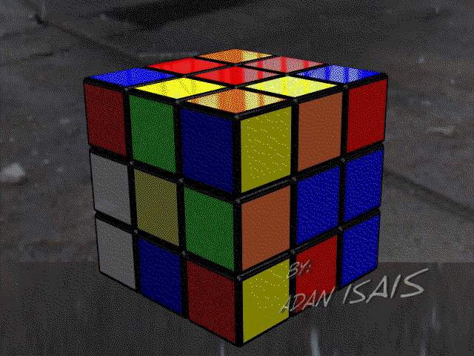
Cube Manipulation
Uses mouse to rotate sides
Raycaster from camera to mouse – collects all intersecting objects and faces
Selects closest object and face – uses them to determine which Cube face to rotate and which axis to rotate on
Direction of mouse movement determines direction of rotation

Slide 6
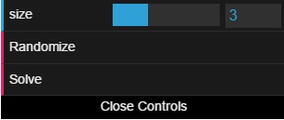
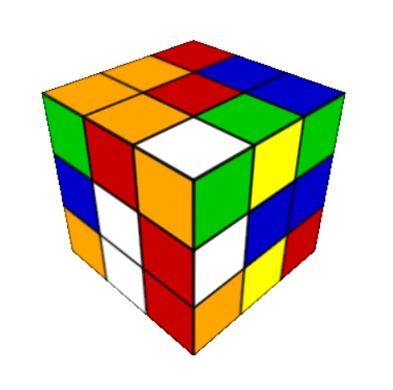
User Interface
Utilizes dat.GUI – lightweight graphical interface
Randomizer – performs series of random rotations
Solver – does not actually “solve”, just creates a new Cube
Size – slider to adjust size from 2 - 5

Slide 7
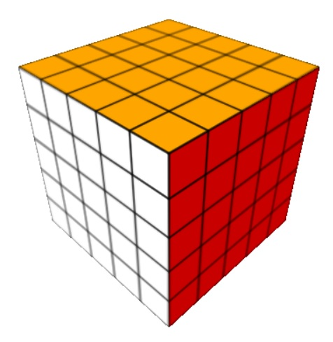
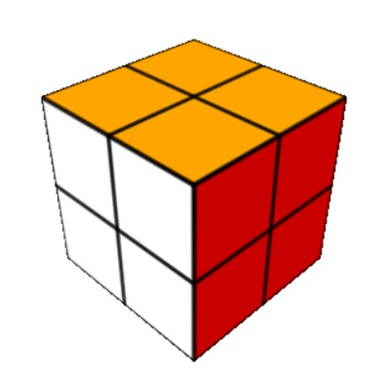
Size Variations
Ranging from 2x2 to 5x5
Deletes old Cube and creates new Cube with new size

Slide 8
Demonstration
http://geo.math.uiuc.edu/new/class198-2016/jea2/project/cubev7.html

Slide 9
Future Improvements
Not fully operational – faces that have been manipulated can no longer work as normal
Cannot be manipulated after size change

Slide 10
Questions / Comments?

Slide 11
Sources
https://en.wikipedia.org/wiki/Rubik's_Cube
https://github.com/dataarts/dat.gui
http://giphy.com/gifs/rubiks-cube-Dq6GBMzxKx1ao
http://giphy.com/gifs/rubiks-cube-31UFhMidcHYQM

