Slide 1
3D Scrabble
In python/opengl

Slide 2
Scrabble
2-4 players
Linearly connected anagrams
Rack of 7 tiles, which are used to make words for points
Special Rules:
Trading
Bonus spaces
Bingo

Slide 3
The Board
A normal (2-dimensional) board is 15x15
An spatially equivalent 3-dimensional board would be 6x6
$∛{15}^{2}$ = 6.08
However, as a player, a 6x6 board doesn’t allow for Bingos
I will design a 8x8 board
8³/225 = 2.28
Allows for Bingos to by played

Slide 4
The Tiles
Alfred Mosher Butts analyzed frequency of letters in publications
He mathematically determined his distribution of tiles
Each letter has a point value, directly related to its rarity of use
Blank tiles (2) are worth zero points and may be used as any letter
I will use the same point values
I could double the number of tiles to keep a close ratio
To keep the game reasonably short, I will keep the same tile distribution
A card-dealing algorithm will handle refilling racks after plays

Slide 5
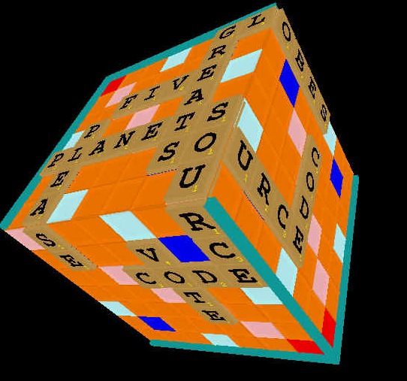
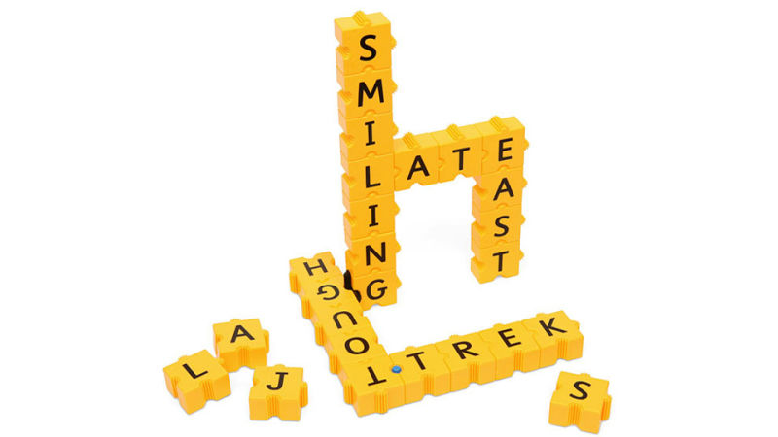
Goals

Slide 6
Additional RTICA Info
Arrow keys vs. mouse
Plans for displaying
Current player’s rack
All scores
Submit button
Notation for bonus value spaces
Hashed dictionary

Slide 7
Potential
This project has potential to expand in the form of:
AI
Sudoku

Slide 8
Sources
https://en.wikipedia.org/wiki/Scrabble
https://i.kinja-img.com/gawker-media/image/upload/s--ykQ5Skt9--/c_scale,fl_progressive,q_80,w_800/17nfcruonjlm3jpg.jpg
http://www.planetsourcecode.com/upload_PSC/screenshots/PIC2002531051354564.jpg

