Slide 1
3D Scrabble
By David Stone

Slide 2
Background
2-4 players
15x15 board
Linearly connected anagrams
Rack of 7 tiles, which are used to make words for points
Special Rules:
Trading
Bonus spaces
Bingo

Slide 3
The Board
A normal (2-dimensional) board is 15x15
An spatially equivalent 3-dimensional board would be 6x6
$∛{15}^{2}$ = 6.08
However, as a player, a 6x6 board doesn’t allow for Bingos
I designed a 9x9 board
9³/225 = 3.24
Allows for Bingos to by played
Creates similar bonus space pattern

Slide 4
Tiles
Game creator Alfred Mosher Butts analyzed frequency of letters in publications
He mathematically determined his distribution of tiles
Each letter has a point value related to its rarity of use
Blank tiles (2) are worth zero points and may be used as any letter
I used the same point values
To keep the game reasonably short, I kept the same tile distribution
Rather than tripling (9³/225 = 3.24)

Slide 5
How is my 3D Scrabble different?
9x9x9 lattice instead of a 15x15 board
98 tiles (no blanks) – randomly shuffled order at the beginning, then drawn sequentially
Arrow keys rotate the board
QWE ASD to move the selector around
Selector determines which location you will place tile
Numbers 1-7 choose which tile you place
H – Help
V – Volume of tiles
P – Points
Enter – submit play
Esc – Quit
Red – Double Word
Blue – Double Letter

Slide 6
Demo
So you can see what that previous slide meant…

Slide 7
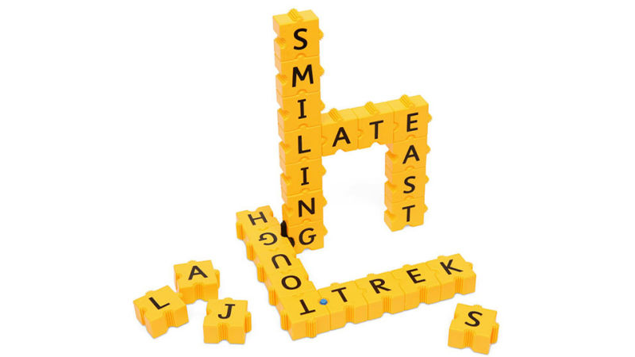
What do you think?
I think I surpassed my original visual goal:

Slide 8
Further Improvements
I expected this to be a code challenge for me
It turned out the be an exploration of graphics
That means some functionalities are left to be written:
Select number of players
Dictionary
Tiles overwriting or incorrectly scoring

Slide 9
Questions/Comments

Slide 10
Sources
https://en.wikipedia.org/wiki/Scrabble
https://i.kinja-img.com/gawker-media/image/upload/s--ykQ5Skt9--/c_scale,fl_progressive,q_80,w_800/17nfcruonjlm3jpg.jpg
http://www.themummyadventure.com/2012_06_01_archive.html
https://www.amazon.com/Mrs-Ratfires-Fabulous-Buys/b/ref=bl_dp_s_web_11067458011?ie=UTF8&node=11067458011&field-lbr_brands_browse-bin=Mrs.Ratfire%27s+Fabulous+Buys%21

