Slide 1
Modeling Water Wheels
Colleen Williams

Slide 2
Modeling Candidate
Subject of Study
History
Turbines for energy
Can be understood easily by watching
Torque/Angular velocity output, gear ratios
Motions of parts can be related in Vpython with frames, variables regarding motion

Slide 3
Some History
Vitruvius, writer of Roman engineering
Hand-grinding grain
Animal power
Water power
First horizontal, then vertical: undershot, over, breast
Channels/aquaducts for
Increase in use after reduced use of slavery in Roman Empire, perhaps Black Plague in Europe, popular until invention of the steam engine
Used in mining to crush earth before smelting
Chinese would use for bellowing fires
Textile mills

Slide 4
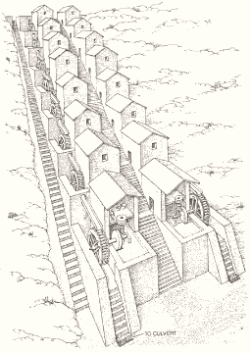
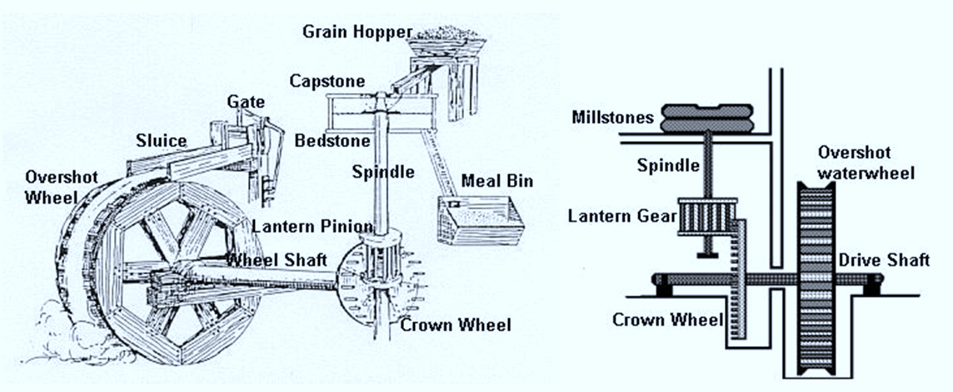
Uses of the Wheel: Flour Mill
Wheel turned by water, turns shaft, gears, eventually a grinding stone to make grain into flour
Low torque, high angular velocity
Roman multiple flour mill in Barbegal, France, used in 2nd Century CE

Slide 5
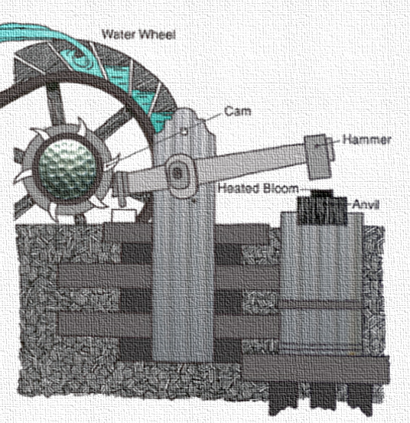
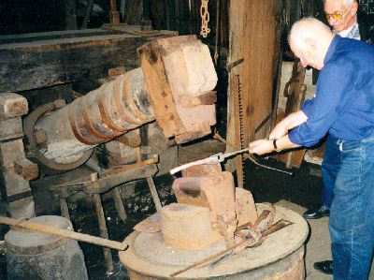
Trip Hammer
Used in Medieval Metalworking, a variation also for mining (stamp mill)
Requires slow rotation but high torque to lift the hammer

Slide 6
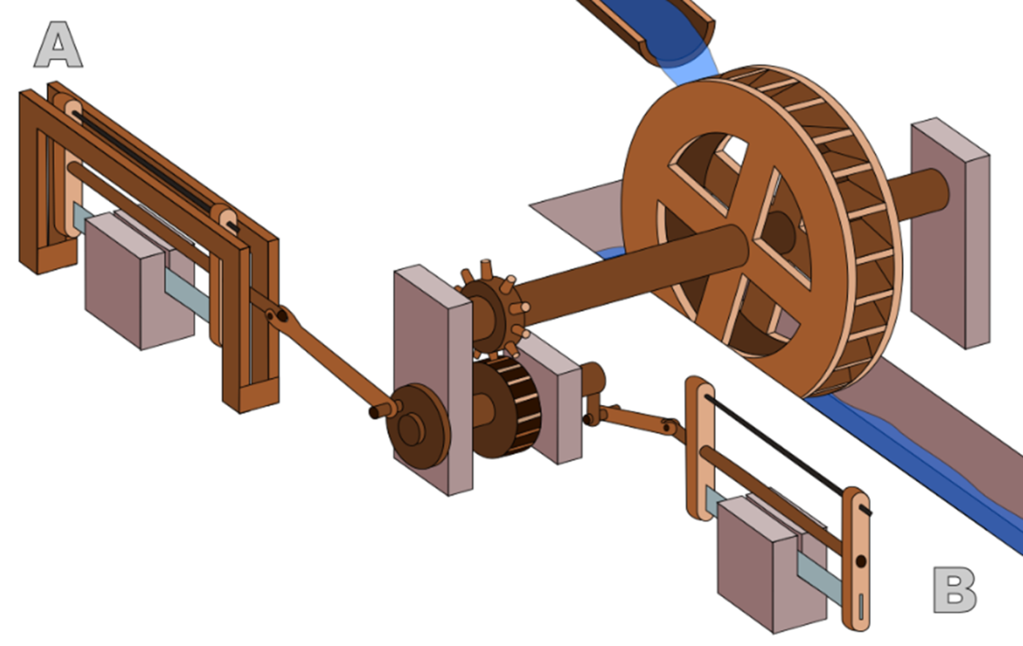
Hierapolis Mill
Earliest known sawmill: 250-300 CE
Used to cut stone blocks for construction
Built for Roman Empire, located in present-day Turkey
Uses linear motion (saws) as well as rotational

Slide 7
Physics/Coding in Vpython
The ability to synchronize motion of water with motion of wheel
is the velocity of the water molecule
is the angular velocity of the wheel’s frame
is the radius of the wheel where water falls onto it; the independent variable (set r=# before creating objects)
#Rotate Wheel
var=1
while(1):
rate(100)
water.pos = water.pos + water.velocity*deltat
t = t + deltat
var=var+1
fwheel.rotate(axis=(r,0,0), angle=-math.pi/20)
sleep(.1)

Slide 8
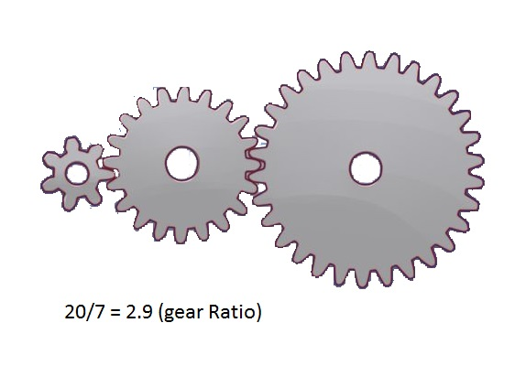
Gears
The gears must have teeth properly lined up; number of teeth must be proportional to a dimension (radius) of the gear
Ratios are in a form $G_{1}$: $G_{1}$ , referring either to a gear radius or number of teeth
The first gear will be input, second output, simplify to a decimal
Think about pedaling a bike on low gear up a hill very quickly, going the same speed as high gear but pedaling slowly

Slide 9
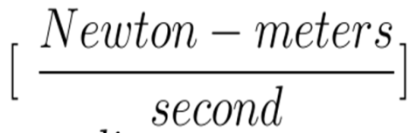
Power, Torque, Angular Velocity
Where Power is in units
Angular velocity is in
And torque is in newton meters
Water does work on the wheel over time, and the same amount would be put out.
The wheel will turn at the same rate in, for instance, the flour mill and trip hammer.
Flour mill grinding stone is of different radius from the hammer, yet both must exert same power
Smaller radius: smaller torque→ must have greater angular velocity
Larger radius: opposite of that

Slide 10
Sources
http://www3.rgzm.de/ephesos/
http://www.ancient.eu/article/907/
http://www.angelfire.com/ia/z/limamill.htm
https://en.wikipedia.org/wiki/Hierapolis_sawmill
https://explorepahistory.com/displayimage.php?imgId=1-2-FB9
https://www.pinterest.com/pin/27021666485199352/
https://www.tu-eshop.com/index.php?route=information/news&news_id=36
http://www.waterhistory.org/histories/barbegal/
http://www.waterhistory.org/histories/waterwheels/#ill4

