Slide 1
Water Wheels In VPython
Colleen Williams

Slide 2
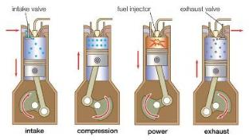
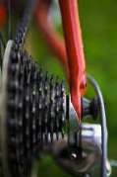
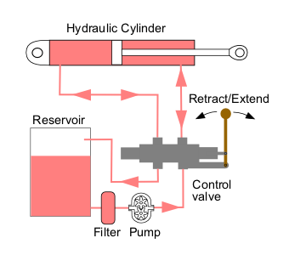
Functions of Water Wheels
Modern machines are based on old ones

Slide 3
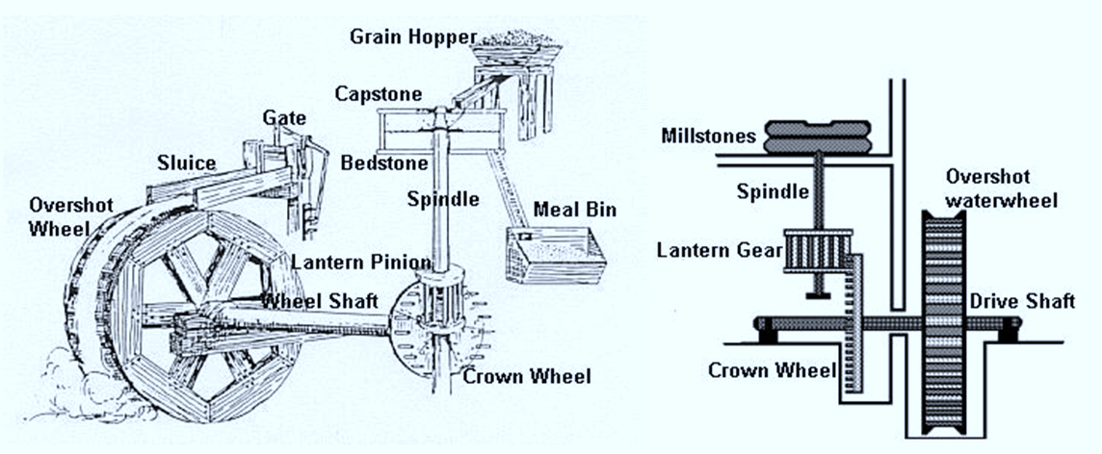
Goals for Each Wheel
Flour Mill
Wheel turned by water, turns shaft, gears, eventually a grinding stone to make grain into flour
Low torque, high angular velocity
Gear ratio of 4:1 (crown: pinion)

Slide 4
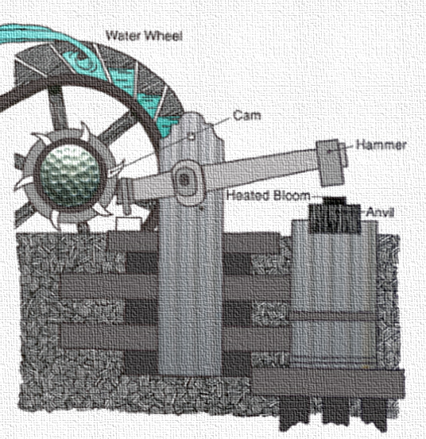
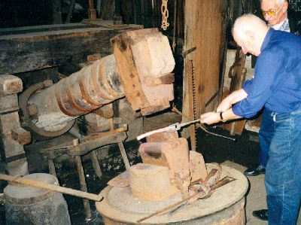
Trip Hammer
One swing of the hammer for each rotation of the main wheel, analogous to 1:1 ratio for gears- requires one cam

Slide 5
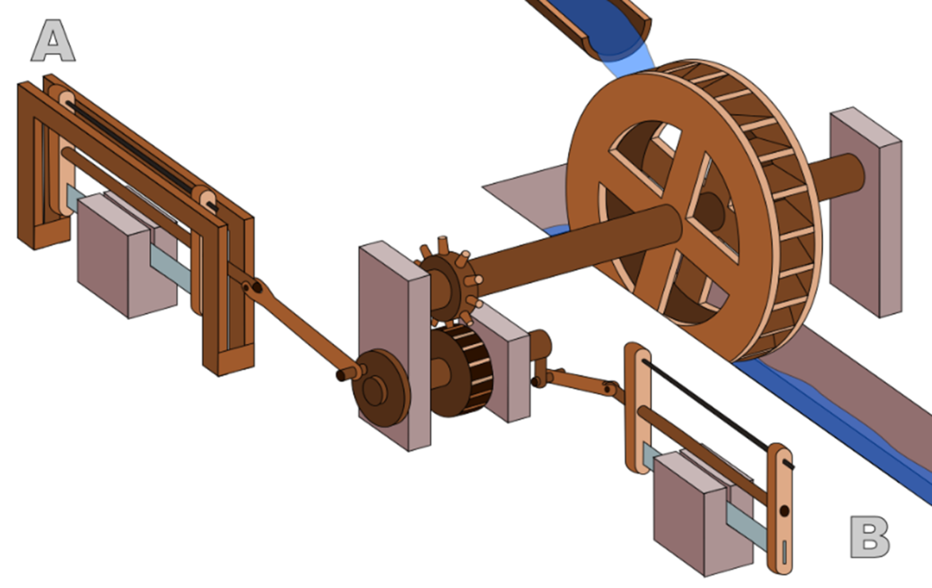
Hierapolis Mill
Convert rotational motion to linear to do work as a sawmill

Slide 6
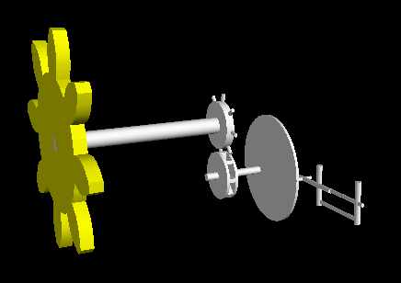
Coding Waterwheels: Frames
fcrown
fsaw
fwheel, same as fworld
fLowWheel
Example of use of frames:

Slide 7
Modeling the Water
Constant velocity (zero acceleration)
Velocity is a vector
Position changes by that vector over time (through frames)

Slide 8
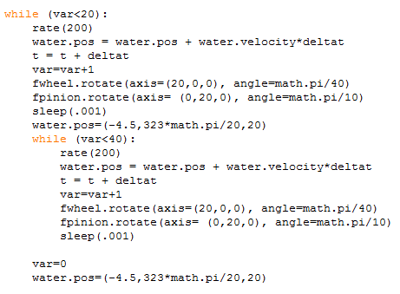
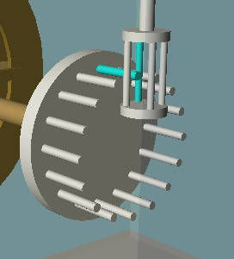
Final Flour Mill

Slide 9
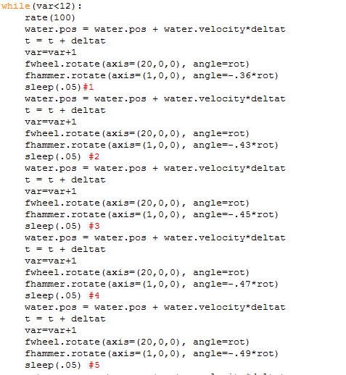
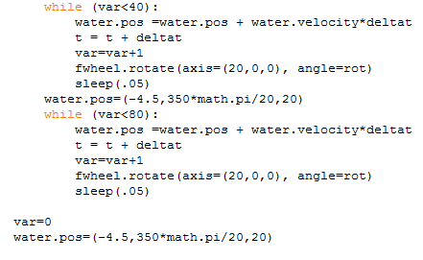
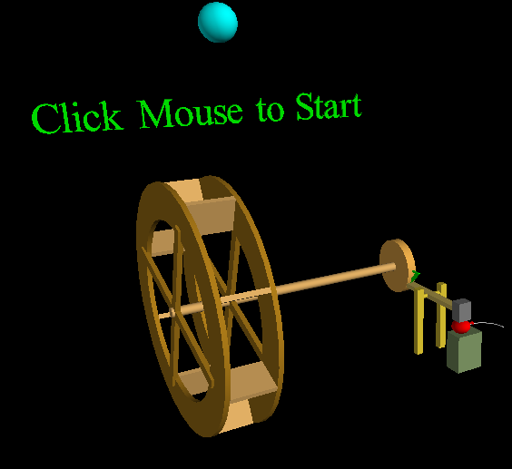
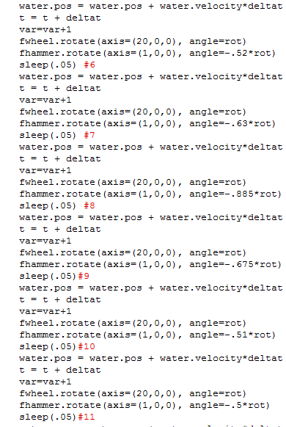
Final Trip Hammer

Slide 10
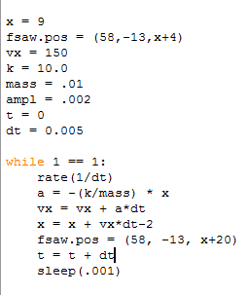
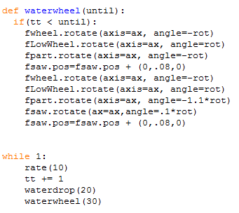
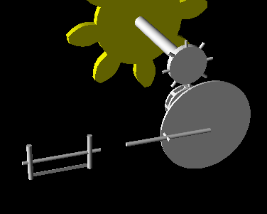
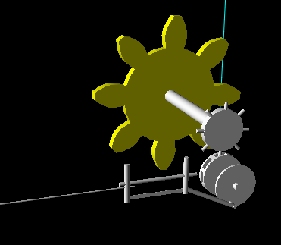
Hierapolis Mill, Not Final

