Slide 1
Guest Lecture: XOR Neural Nets
In Math 490 (Prof Kay Kirkpatrick)
“Mathematics of Machine Learning”
19 October 2018
George Francis, email: gfrancis@illinois.edu
Notes at http:new.math.uiuc.edu/TraskXOR

Slide 2
Perceptron (Wikipedia)
Name was coined by Rosenblatt 1957
Notes:
Good webbpage:hover:quick def but click: hyperlink to more information
Rosenblatt and Minsky (co-author with Seymour Papert ) were in Bronx HS of Science together.

Slide 3
Perceptron, a good graphic
Notes:
Heaviside function f(x) = (Wx +b ? 1 : 0); in C-speak

Slide 4
Another good figure (Wikipedia)

Slide 5
Perceptron, a bad figure

Slide 6
Cover of Minsky & Papert “Perceptrons” 1969, 1987
Notes:
Comment: Humans have difficulty resolving optical illusions using their visual systems alone.
Connectionists (whwho believe that computers model human brains)
Argued (Papert) that perceptron failures on XOR is somehow relevant. RHS: decorated image resolves illusion.

Slide 7
Papert: Perceptrons can’t learn XOR

Slide 8
The XOR-Affair (Wikipedia)

Slide 9
It’s never that simple (Stackoverflow)

Slide 10
Controversy (ai.stackexchange.com)
Notes:
Stack exchanges are Q&A websites on steroids, mainly they are curated and hierarchical (reputation ranks)

Slide 11
Rumelhart, Hart, MacClelland 1986 (End of the Controversy)

Slide 12
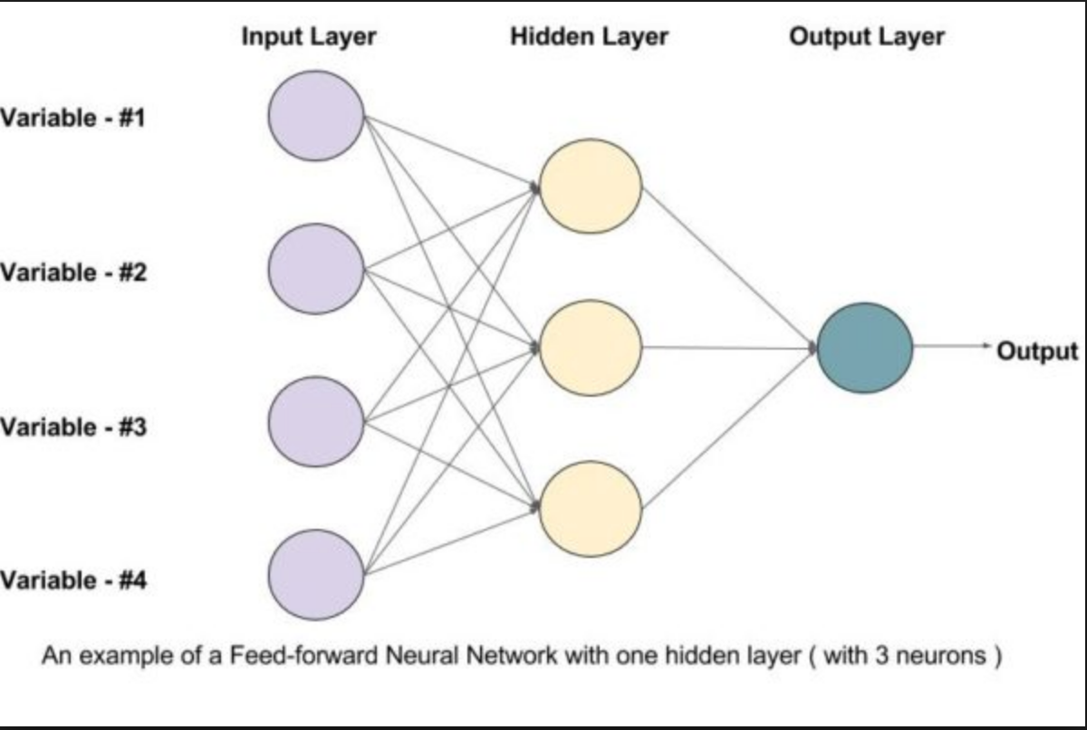
Not a Perceptron

Slide 13
Andrew Trask

