Slide 1
Lindfern
Lindenmayer Systems in VPython
Nick Langhammer

Slide 2
What is a lindenMayer system?
Introduced by biologist Aristid Lindenmayer in 1968 to model plant growth
Lindenmayer systems, or L-systems, are parallel rewriting systems
Used to generate self-similar fractals

Slide 3
Components of lindenmayer systems
Each system starts with an axiom and has a set of production rules
These rules are applied to the respective components of the axiom
The number of times the rules are applied is the number of iterations

Slide 4
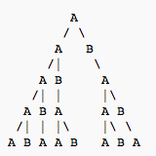
example
Axiom=A
Rules=(A to AB), (B to A)

Slide 5
Typical commands in turtle graphics
F=move forward
+ = turn left
- = turn right
[ puts the current position and direction on top of a stack
] pops the entry off of the top of the stack

Slide 6
My project
Create a 3D representation of Lindenmayer systems in VPython

Slide 7
constructING Branches
Position stored in 3 arrays-aa,bb, and cc
Axis stored in 2 arrays-dd and ff
  Length is always 3, radius is always .25

Slide 8
My commands
F=create a branch using the current position and axis
R=change the array dd to 1 to make the next branch lean right
L=change the array dd to -1 to make the next branch lean left
T=change the array ff to 1 to make the next branch lean forward
B=change the array ff to -1 to make the next branch lean backward
P=change the item in each array to the item it was before the previous branch was constructed

Slide 9

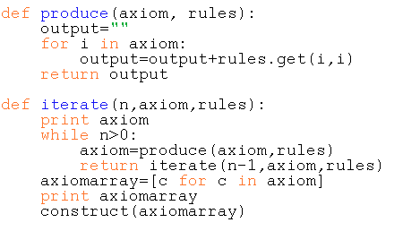

How my program works
Takes axiom and rules
Applies rules to axiom
Returns results in a string

Slide 10
Contd.
Converts string to array
Reads each item one at a time and performs the corresponding action

Slide 11
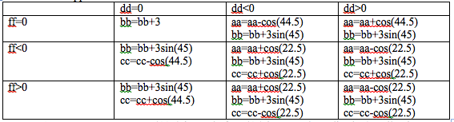
Transformations to position depending on axis

Slide 12

Using the program
Change axiom and rules however you want
Change value of number in the iterate function at the bottom to choose the desired amount of iterations
Run module

Slide 13
Possible future changes
Randomize axiom and production rules
Allow branches to extend more than 45 degrees
Let the lengths and radii of cylinders change with number of iterations
Improve user interface so that users can enter the axiom, rules, and number of iterations while the module is running

