Slide 1
Predator prey cellular automaton
Suharsh Sivakumar
December 11, 2010

Slide 2
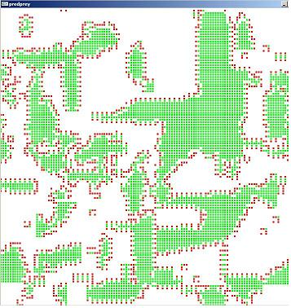
Cellular Automaton
A grid of cells where all the cells are governed by a common set of rules based on the number of adjacent neighbors.
As generations go by, the rules work together to show very interesting phenomena in the big picture.

Slide 3
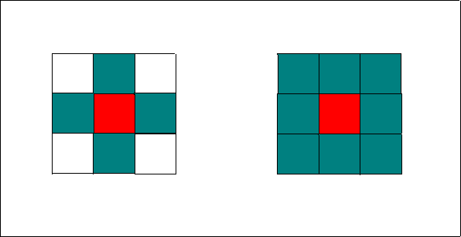
Defining the Neighborhoods
There were two ways I could define neighborhoods:
  Von Neumann- only four
  Moore – all eight
I chose Moore, because it had “Moore” flexibility in the rules.
Von Neumann and Moore neighborhoods.

Slide 4
Equilibrium
There are three possible equilibriums:
  Prey go extinct and predators quickly follow.
    Both extinct
  Only predators go extinct.
    Predators extinct
  Both prey and predators fluctuate around an equilibrium point.
    Both live

Slide 5


Making the Rules
Want to choose rules that will make the sinusoidal solution to the Lotka-Volterra Equations.
To find this values I just guessed and checked until I found values that caused the program to maintained itself.

Slide 6
The Rules
Each cell has the same set of rules for each of the three cases: where it is a predator, or prey, or empty square.
The rules for each square are dependent only on it immediate neighbors, but the Lotka Volterra Equations say nothing about immediate neighbors--- it only talks about the total number.

Slide 7
Predator Cell Rules
A predator cell lives (stays red) if there is prey around it.
A predator cell dies (becomes black) if there is no prey around it.
To model this I created a function that counts the number of prey around a cell.
Then I used this to say:
  If prey > 0 then predator lives.
  Else predator dies.

Slide 8
Prey Cell Rules
A prey cell lives (stay green) if there aren’t enough predators to eat it.
A prey cell dies (becomes black) if there are enough predators to eat it.
If there are too many predators around a prey cell, then the predators eat and reproduce into the cell. (becomes red)
If 0 < predators < 5 then prey remain alive.
If predators > 4 then prey “becomes” predator.
Else prey remains alive.
To add overpopulation I counted the amount of prey around a cell and said if prey > 7 then the cell dies.

Slide 9
Empty Cell Rules
An empty cell becomes prey (becomes green) if there are more prey than predators.
An empty cell becomes predator (becomes red) if there are more predators than prey.
If no majority, the cell stays empty (stays black).
If prey > predator then prey.
If predator > prey – 1 then predator.
Else empty.

Slide 10
Both live
This is the interesting one.
Without overpopulation
  Looks like the ratio of prey to predators fluctuates around 3.0.
With overpopulation for prey
  Looks like the ratio of prey to predators fluctuates around 2.2.
If you look at the numbers you can see that they fluctuate in a somewhat sinusoidal way.

Slide 11
THE END
If anyone want to make a cellular automaton of your own:
Cellular Automaton Skeleton
You can edit it to have as many states you want, you will just have to also edit the rules.
But the framework and definition of cells has already been done.

