Slide 1
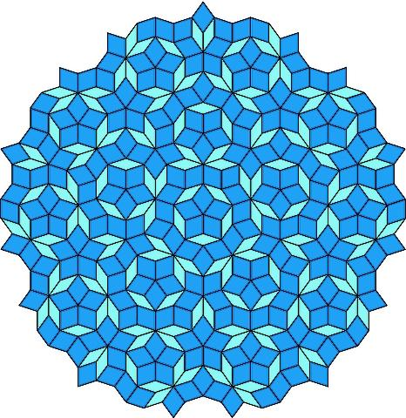
Explorations in Experimental Mathematics
Tejo, Pranav, Manting, Sung Jib, Lisa

Slide 2
Experimental Mathematics
“Experimental mathematics is an approach in which computation is used to investigate mathematical structures and identify their fundamental properties and patterns”
For this project, python code was developed to explore cobweb plots of the logistic chaos equation
Logistic chaos equation: y=4*a*(1-x)*x

Slide 3
Process of Coding
Our group attended Stefan Klajbor’s Python workshop, which taught us the basics to code this program
We have python versions using the TkInter and Turtle libraries
A Javascript version is being developed by our group as well

Slide 4
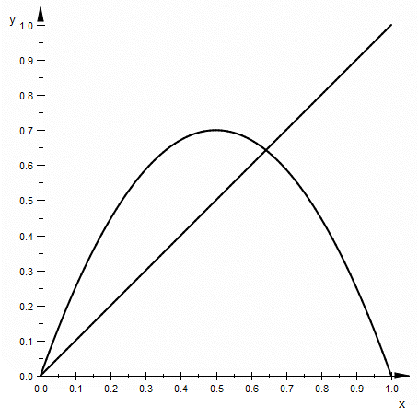
Cobweb plots AKA Verhulst Diagram
Shows the behavior of chaotic orbits in dynamical systems
A cobweb plot repeats the following steps during each iteration:
Find a starting point on the curve (x,f(x) )
Plot a horizontal line from this point to the diagonal line y=x
  The coordinates of this point are ( f(x), f(x) )
Plot a vertical line from this point to the curve
  The coordinates of this point are ( f(x), f(f(x)) )
The next iteration begins from this point on the curve

Slide 5
Behaviors of Cobweb Plot
Using Experimental Mathematics, we looked into the behaviors of the cobweb plot with the function: y=4*a*(1-x)*x
Using this approach, we have discovered four distinct behaviors:
  a<.25 : graph dies (converges to 0)
  .25<a<.5: converges to nonzero point
  a>.5:
    .5<a<.96: Period 2
    a= .96: Period 3
  a> .96: Chaotic

Slide 6
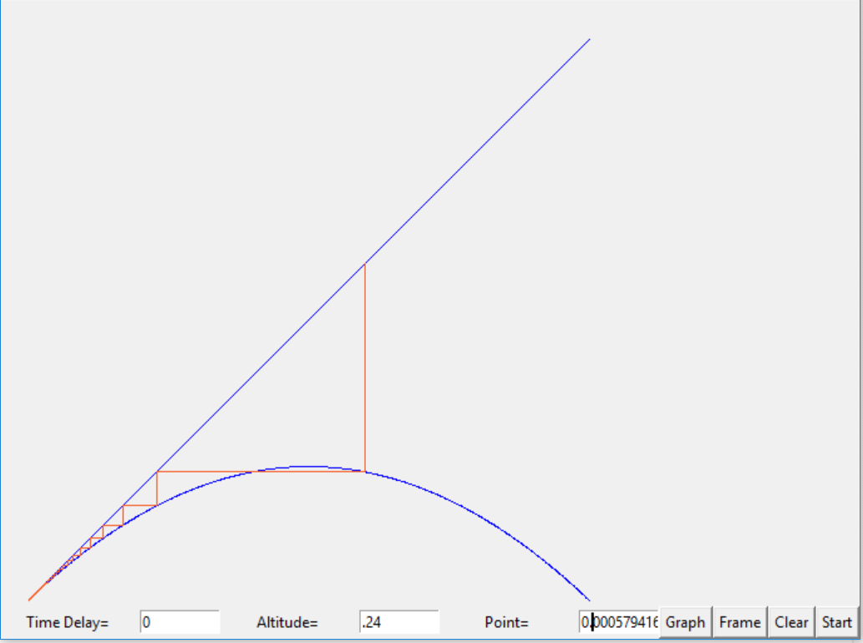
Behavior 1
a<.25
The graph converges to 0 for altitudes of these values

Slide 7
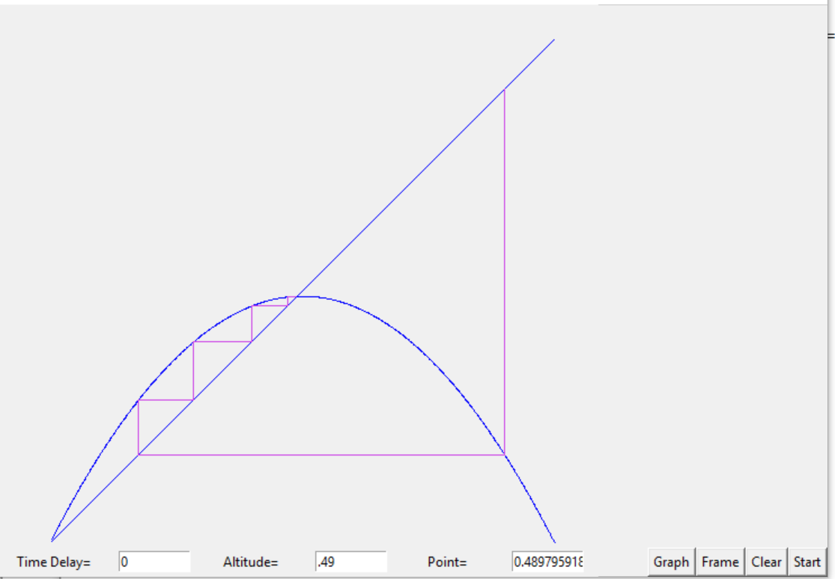
Behavior 2
.25<a<.5
The graph converges to a single, nonzero point for altitudes of this value

Slide 8
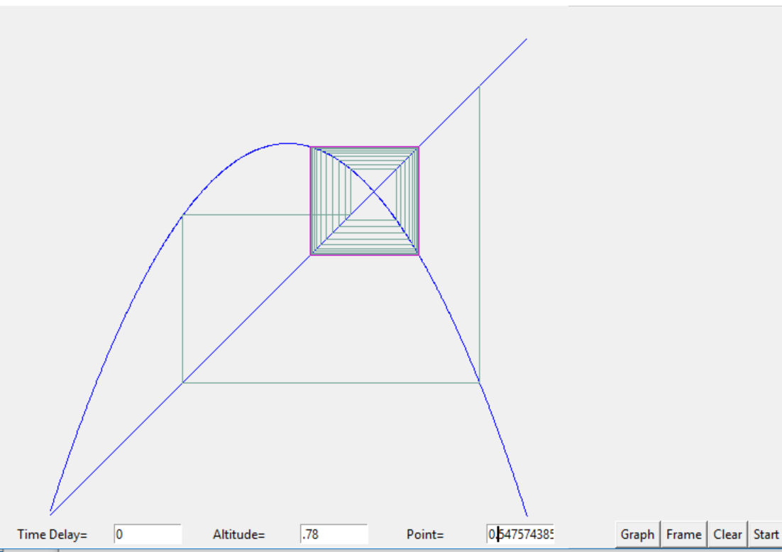
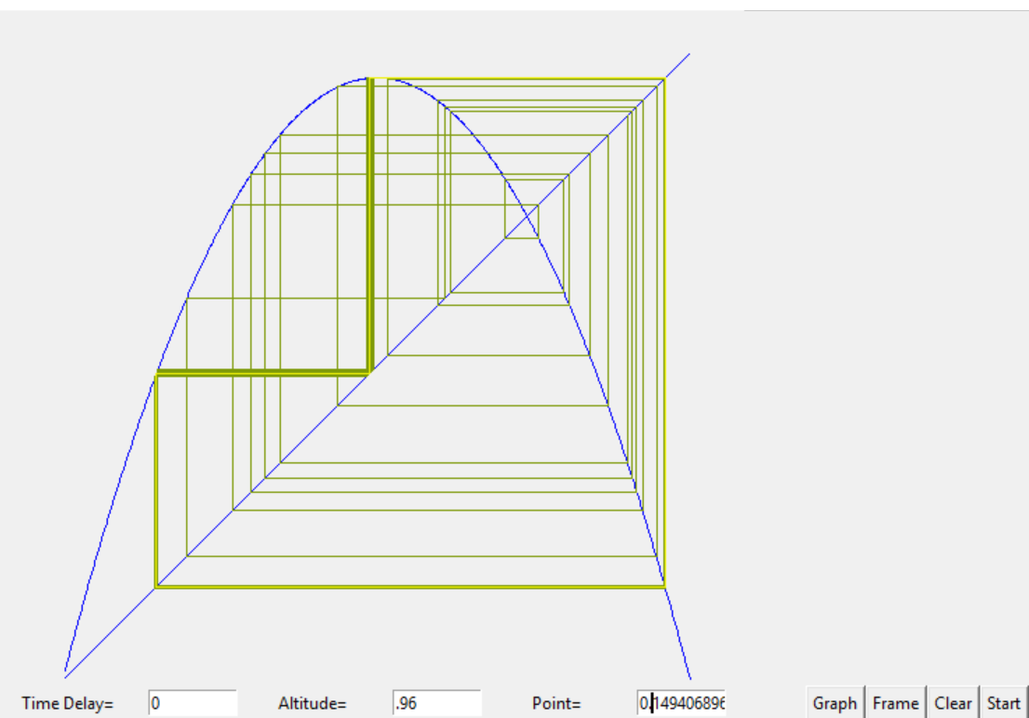
Behavior 3
.5<a<.96
The graph is multi-period
Sharkovsky’s Theorem: if a continuous real function has a periodic point with period 3, then there is a periodic point of period n for every integer n.

Slide 9
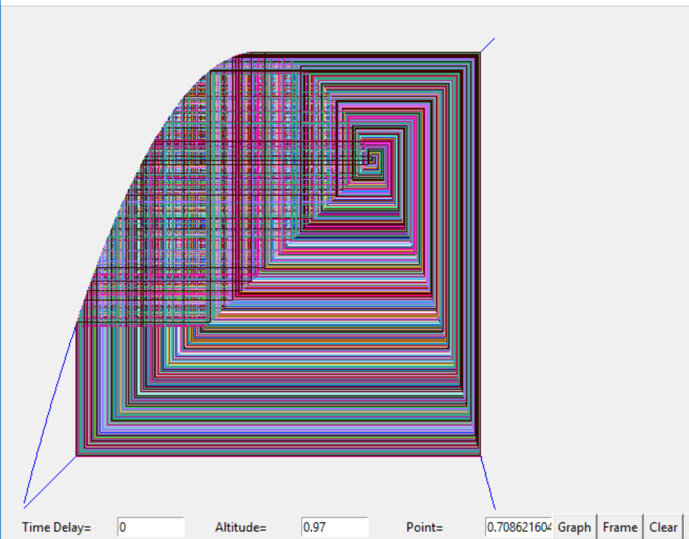
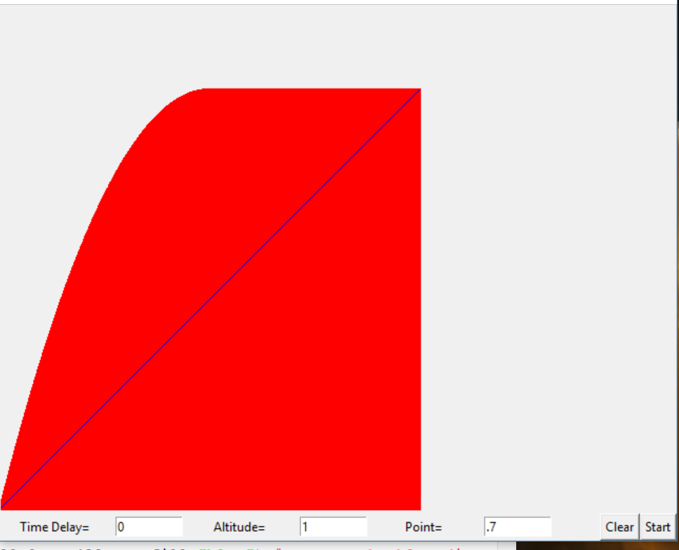
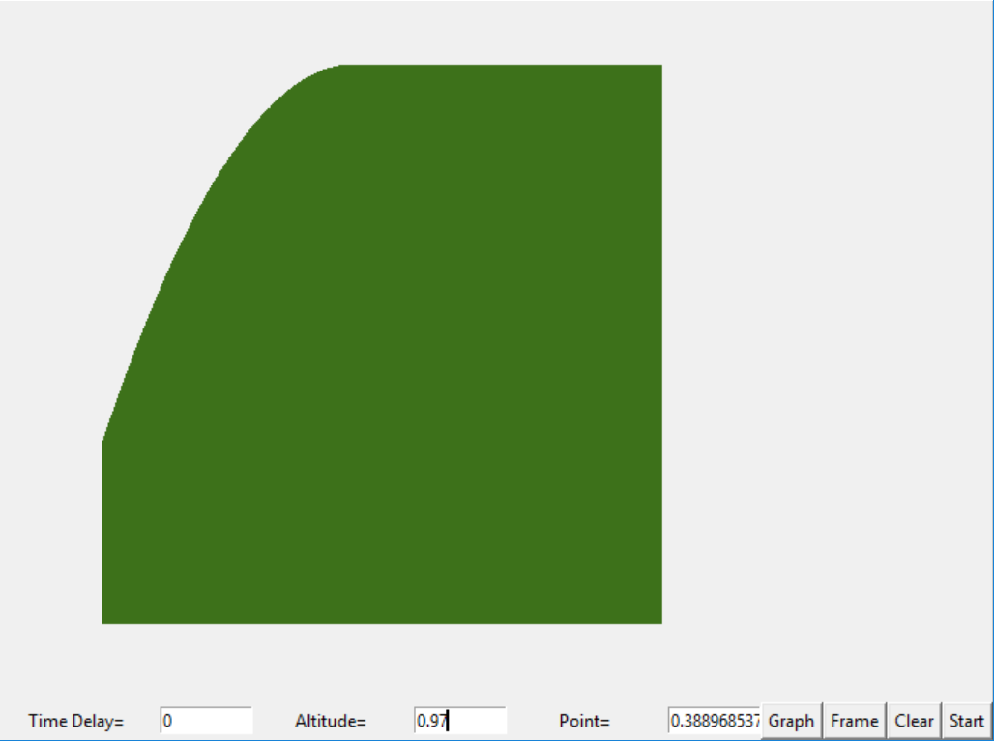
Behavior 4
For altitudes greater than 0.96 (a>0.96) the cobweb plot does not converge to any number of points
The graphs below show how after many iterations, the cobweb plot displays chaotic behavior by filling the visible portion of the graph

Slide 10
Demonstration
Sample altitudes
  a= .2
  a= .45
  a= .77
  a=.96
  a=1

Slide 11
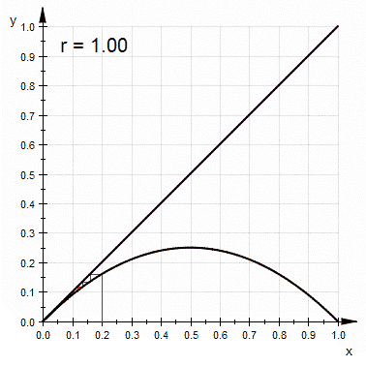
All Together
The graph on the right show all the behaviors as the altitude, a, goes from .25 to 1
Note that r = 4*a

Slide 12
Stability of 2D Quasicrystals
Using computer animations, we can apply the experimental mathematics approach to analyze the rigidity of Quasicrystals in 2D and 3D
Wester 2D game
Wobble.html

Slide 13
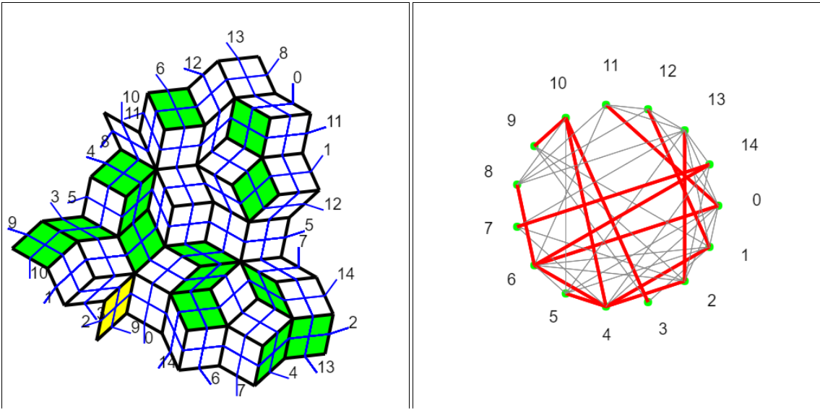
Wester 2D Game
Using the theorems of Wester, Baglivo, and Graver
Bracing the the rhombi corresponding to the edges of the spanning, connected subgraph makes it rigid
Proof of the 2D case
The following is a possible solution for rigidity of the carpet
Note the corresponding graph

Slide 14
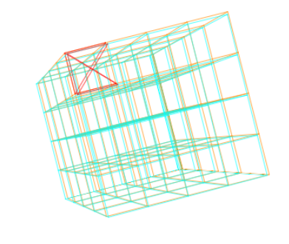
Wobble.html
Use this program to extend theorems for the 2D case to the 3D case for blocks
Eventually plan to extend the 3D grid to a 3D rhombic cluster
More complex shifts
Using :
  Tunnel conjecture
  Shadow conjecture

Slide 15
Bibliography
"Experimental Mathematics." Experimental Mathematics -- from Wolfram MathWorld. N.p., n.d. Web. 08 Mar. 2017.
"Cobweb plot." Wikipedia. Wikimedia Foundation, 18 Feb. 2017. Web. 08 Mar. 2017.
Stoop, Ruedi; Steeb, Willi-Hans (2006). Berechenbares Chaos in dynamischen Systemen[Computable Chaos in dynamic systems] (in German). Birkhäuser Basel. p. 8. ISBN 978-3-7643-7551-5.
Stoop, Ruedi; Steeb, Willi-Hans (2006). Berechenbares Chaos in dynamischen Systemen[Computable Chaos in dynamic systems] (in German). Birkhäuser Basel. p. 8. ISBN 978-3-7643-7551-5.
Wobble.html: IGL team: Dan Pugliese, Chong Han, Joe Zeller, Zach Miksis ; Mentors: George Francis, Eliana Duarte
Wester game: IGL team: Chong Han, Alec Mori, Dan Publiese, Joe Zeller, Zach Miksis ;Mentors: Eliana Duarte, George Francis

